Slide 1
Presentation
Sai Sruthi Bodapati

Slide 2



Hollywood Movie Dataset includes:
Profitability (Worldwide Gross / Budget)
< 1
= 1
> 1
74 movies released between 2007 to 2011
Random sample extracted by Tableau from source InformationIsBeautiful.net
6 Genres, Worldwide Gross, Audience and Rotten Tomatoes Score (Critic review)
Other: 12 Lead and independent Studios and Year Released
Notes:
There are 8 columns and 74 observation from the dataset
Random sample sources from InformationIsBeautiful.net
6 Genre including Action, Animation, Romance,Comedy etc
Profitability = worldwide gross/budget
In our study, we are focusing on 5 factors including genre, profitability,worldwide gross, audience score and rotten tomato score from the dataset

Slide 3

Hollywood Movie: Research Questions
Purpose: Investigate factors related to worldwide gross and zzzzzzzzz rating of a movie, including relationship between:
Genre and Profitability
Audience score and Rotten Tomatoes score
Audience score and Profitability/Worldwide Gross
Audience score and Genre

Slide 4
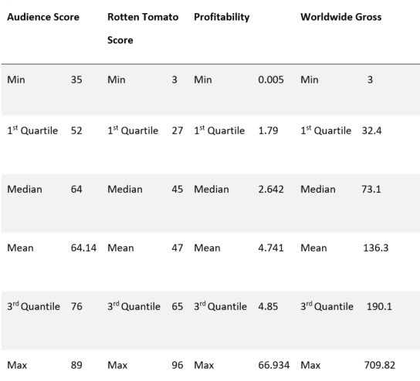
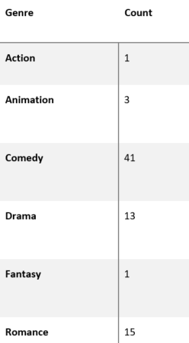
Descriptive Stats
Notes:
As we can see, the range of profitability is very large, from 0.005 to 66.934, with the point estimate of 4.785, which means the movies produce profit more than 478.5% of their own budget on average. Also, we notice that the gap between 3rd Quantile and the Maximum is quite large, so outlier might exist in this case.
The mean and median of audience score are very close, only 0.04 difference between them. They are also close to the critical point, 60, to define the rotten/fresh status.

Slide 5
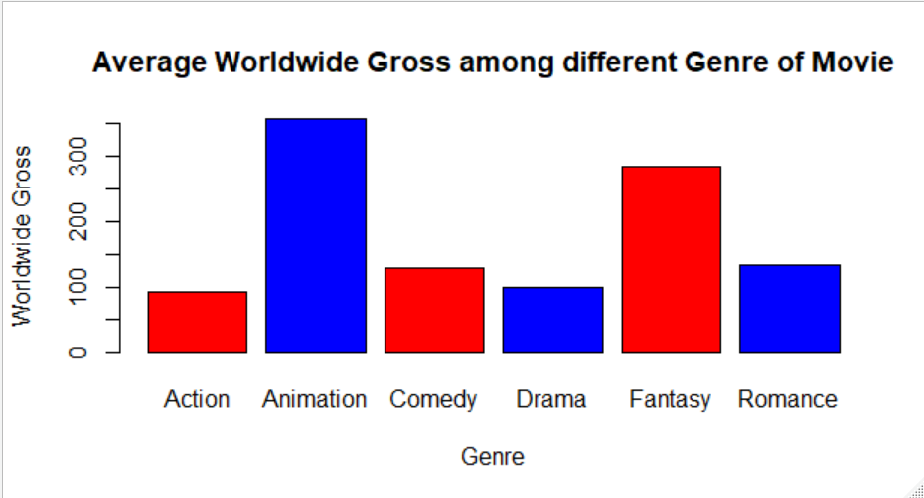
Genre and Worldwide Gross
ANOVA Test
Inspect mean of worldwide gross for each genre are the same
P-value: 0.172 (Not significant)
Test for Significance
P-value > 0.05 (Not significant)
No evidence to support there is linear relationship between Genre and Worldwide Gross
Notes:
Different Genre has different P value, it is not possible to list all of it on the slide. But all of them are greater than 0.05 so we are not able to reject the Null Hypothesis

Slide 6
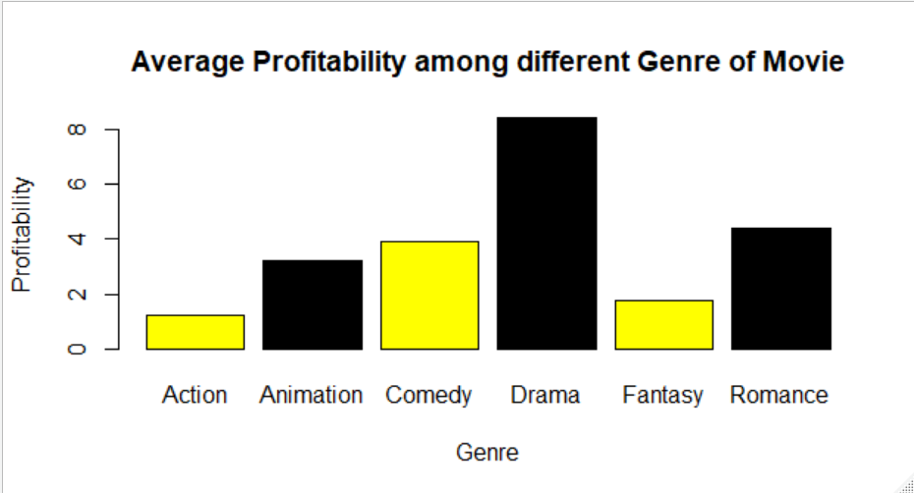
Genre vs. Profitability
ANOVA Test
Inspect if population mean of profitability for each genre are the same
P-value: 0.661 (Not significant)
Test for Significance
P-value: >0.05 (Not significant)
No evidence to support there is linear relationship between Genre and Profitability
Notes:
Different Genre has different P value , it is not possible to list all of it on the slide. But all of them are greater than 0.05 so we are not able to reject the Null Hypothesis

Slide 7
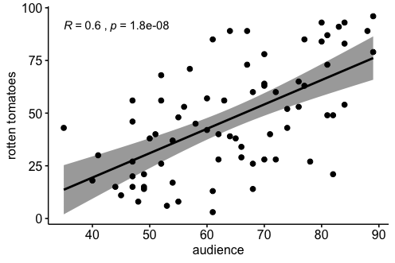



2) Audience Score & Rotten Tomatoes Score
Anova Test
P-value: 0.000001 (Significant!)
When Audience Score ↑, Rotten Tomatoes Score ↑
Fisher’s LSD
Rotten Tomato Score | Category | Audience Score | Groups
75% or higher | Certified Fresh zzzz | 78.36 | a
At least 60% | Fresh z | 69.00 | a
Less than 60% | Rottenzz | 59.08 | b
Notes:
Observation from the scatter plot: audience score increase as rotten tomato score
Anova Test: P value is smaller than alpha
Reject Null hypothesis so there are difference in population mean of audience score within Rotten tomato score
Conduct Fisher’s LSD to locate the differences
convert Rotten Tomato score into categorical data and divided it into 3 categories according the scales from official.
“Rotten” is different from other sample group

Slide 8
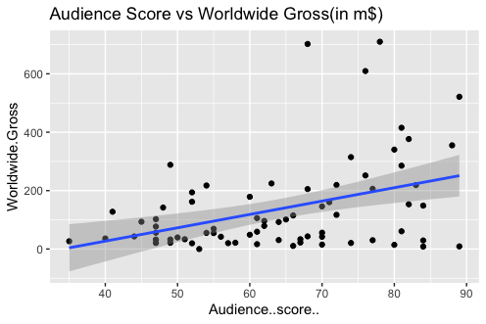
3) Audience Score and Worldwide Gross
Test for significance
P-value: 0.00537 (Significant!)
15.63% of variability of Worldwide Gross can be explained by Audience Score
Other possible contributing factors
Correlation Coefficient: 0.40
Notes:
15.63% of the variability of worldwide gross of movie can be explained by the audience score,
many other possible contributing factors such as number of advertisements, choice of actor/actress or number of awards winning.

Slide 9
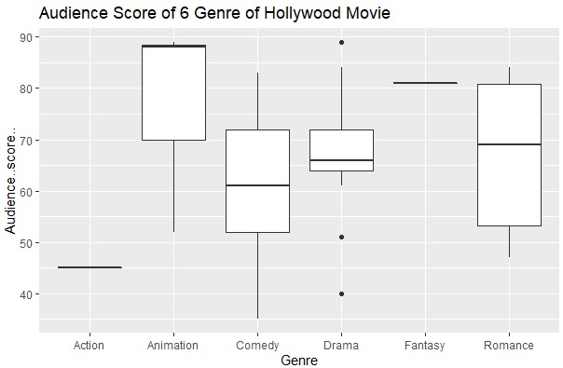
4) Audience score and Genre of Movie
ANOVA test
Inspect if the mean of Audience Score are the same among all genres
P-value: 0.113 (not significant)
❋Both Action and Fantasy Genres have only 1 data (More data needed for further analysis)
Notes:
dataset collected by random sampling method
cannot control how many movies in a genre can be included
only one Action movie and one fantasy movie included
p-value>0.05
cannot prove that the mean audience score are different among different genres of movies

Slide 10



Conclusion & Suggestion
Worldwide gross and profitability do not influenced by genre of movie
Audience score and Rotten Tomato Score is positively related but there is significance difference between two systems
Worldwide gross of a movie can be explained by its audience score
Suggestion: Encourage fans to rate the movie on Rotten Tomato Website; conduct test with a larger dataset of movie from different genre; research on more factors that relate to worldwide gross
Notes:
Worldwide gross and profitability do not influenced by genre of movie since there is no linear relationship between both factors and genre. However, we can still provide some descriptive statistics according to the different lead studio for movie producer as references.

